Slide 1
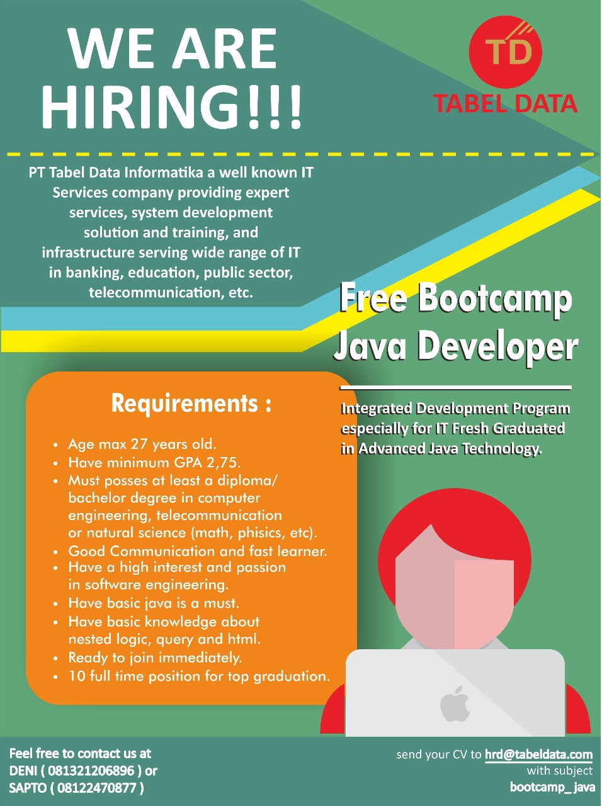
Bootcamp Java Developer #Day 3
PT. Tabel Data Infromatika
By Dimas Maryanto,S.Kom

Slide 2
Spring Web MVC
The Spring Web model-view-controller (MVC) framework is designed around a DispatcherServlet that dispatches requests to handlers, with configurable handler mappings, view resolution, locale, time zone and theme resolution as well as support for uploading files. The default handler is based on the @Controller and @RequestMapping annotations, offering a wide range of flexible handling methods. With the introduction of Spring 3.0, the @Controller mechanism also allows you to create RESTful Web sites and applications, through the @PathVariable annotation and other features.

Slide 3
Defining Controller & RestController
RequestMapping
GetMapping
PostMapping
PutMapping
DeleteMapping
ModelAndView
ModelMap
BindingResult
Valid
ModelAttribute
RequestParam
URI Template Patterns
PathVariable

Slide 4
Configure Template Engine
Java Server Page & Jsp Standart Tag Library
Thymeleaf
Apache Velocity
Freemarker
JasperReport

Slide 5
Serving of Resources
This option allows static resource requests following a particular URL pattern to be served by a ResourceHttpRequestHandler from any of a list of Resource locations. This provides a convenient way to serve static resources from locations other than the web application root, including locations on the classpath.

Slide 6
Handling Request & Response dengan Spring Framework Web MVC

Slide 7
Form with Spring Taglib

